Slide 1
Law of Demand
Copyright@Ashis Kumar Pradhan

Slide 2
Demand!
The quantity of good or service that consumers are willing and able to purchase at various prices during a given period of time.
Law of Demand Proposed by: Charles Davenant (1656-1714)
Demand depends upon these three things
Desire for a commodity or service
Willingness to purchase
Capability to purchase

Slide 3
Factors affecting the Demand
(i) Price of the commodity: Ceteris paribus, the demand for a commodity is inversely related to its price.
(ii) Price of related commodities:
(a) Complementary goods, (b) Substitute goods
(iii) Income level of the household: The larger the average money income of the household, the larger is the quantity demanded of a particular good.
(iv) Taste and Preference of the consumer: Goods which are more in fashion command higher demand than those goods which are out of fashion.
(v) Population: Lager the size of a country’s population greater is the demand of the goods.
(vi) Climatic conditions: Seasonal variations affect the prices of certain goods.
a.
Capability to purchase

Slide 4
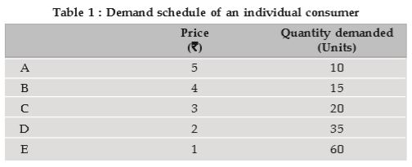
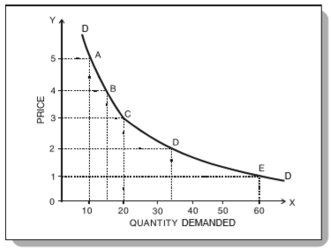
Law of Demand
Ceterus Paribus, if the price of a commodity falls, the quantity demanded of it will rise and if the price of a commodity rises, its quantity demanded will decline.
Therefore, there is an inverse relationship between price and quantity demanded, other things being the same.

Slide 5
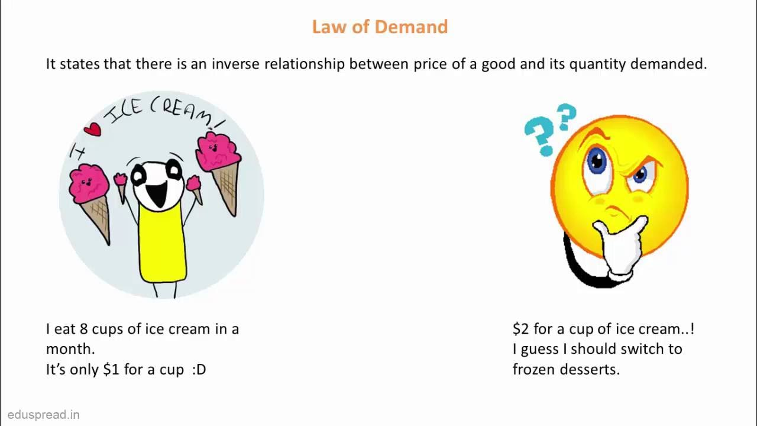

Slide 6
Why Demand curve Slopes Downward?
(i) Law of Diminishing marginal utility: People will buy more of a commodity at a lesser price because they want to equalise the marginal utility of the commodity with the price. So a rationale consumer will not pay more for lesser satisfaction.
(ii) Substitution effect: When the price of a commodity falls, it becomes relatively cheaper than other commodities. It induces consumers to substitute the commodity whose price has fallen for other commodities which have now become relatively expensive.
(iii) Income effect: When the price of a commodity falls, the consumer can buy the same quantity of the commodity with lesser money or he can buy more of the same commodity with the same amount of money.

Slide 7
Why Demand curve Slopes Downward?
(iv) Arrival of new consumers: When price of a commodity falls, more consumers start buying it because some of those could not afford it previously.
(v) Different uses: Certain commodities is known for its multiple uses. If their price fall they will be used for varied purposes and hence demanded more.

Slide 8
Exception to the Law of Demand
(i) Veblen Goods: Articles of prestige value or snob appeal or articles of conspicuous consumption are demanded only by the rich people and these articles become more attractive if their prices go up. This effect is called Veblen effect or prestige goods effect.
(ii) Giffen Goods: Sir Robert Giffen, an economist, found that the price of bread increased, the British workers purchased more bread and not less of it. The reason given for this is that when the price of bread went up, it caused such a large decline in the purchasing power of the poor that they were forced to cut down the consumption of meat and other more expensive foods.
(iii) Conspicuous Necessities: Certain commodities are affected by demonstration effect. These goods, due to constant usage, have become necessities of life.

Slide 9
Exception to the Law of Demand
(iv) Future Expectations about Prices: When the prices are rising, households expecting that the prices in the future will be still higher, hence they tend to buy larger quantities of the commodities.
(v) Irrationality of the Consumers: The law assumes consumers to be rational and knowledgeable about market conditions. However, at times consumers tend to be irrational and make impulsive purchase without any rational calculations about prices.
(vi) Demand for Necessities: The law of demand does not apply much in the case of necessaries of life. Irrespective of price changes, people have to consume the minimum quantities of necessary commodities.

Slide 10
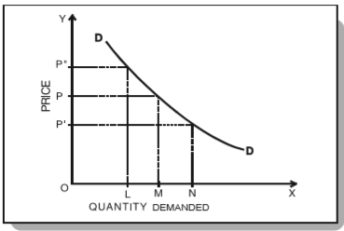
(Change in Quantity Demanded) Expansion and Contraction of Demand
*The concept of expansion of demand explains the increase in the demand of certain goods or services due to a fall in its price other things remaining constant.
*The concept of contraction of demand explains the decrease in the demand of certain goods or services due to a rise in its price other things remaining constant.

Slide 11
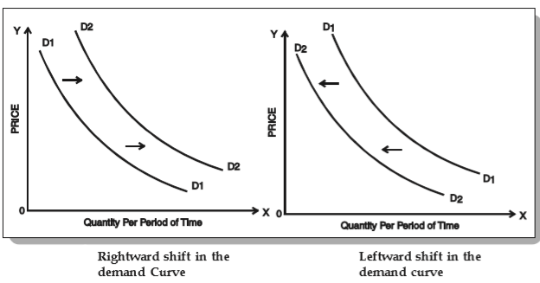
(Change in Quantity Demand) Increase and Decrease in Demand
*The concept of increase in demand explains about the shift in the demand of certain goods or services outward/rightward due to a change in other factors affecting demand, prices of those goods and services remaining fixed.
*The concept of decrease in demand explains about the shift in the demand of certain goods or services inward/leftward due to a change in other factors affecting demand, prices of those goods and services remaining fixed.

Slide 12
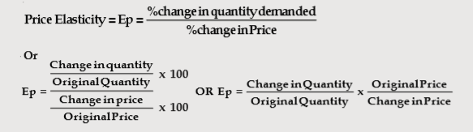

Elasticity of Demand
Elasticity of Demand refers to the responsiveness of the quantity demanded of a good to a change in one of the variables on which demand depends. Variants: Price elasticity, Income elasticity, Cross elasticity.

Slide 13
Thanks!
Any questions?

